Slide 1


U and Uu Matra Words

Slide 2
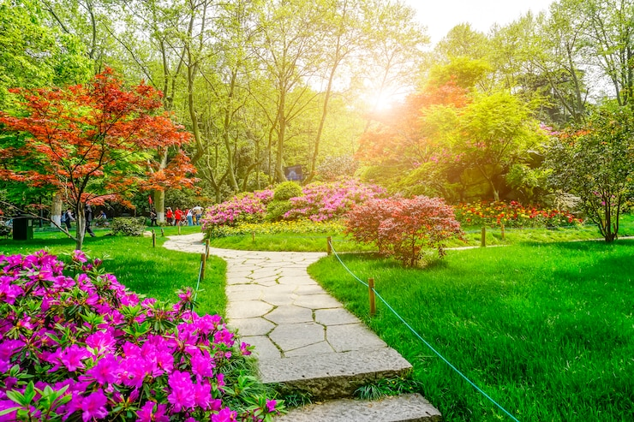
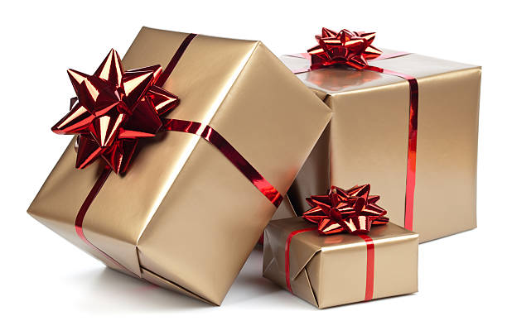
U and Uu Matra Words
Garden
Gift

Slide 3
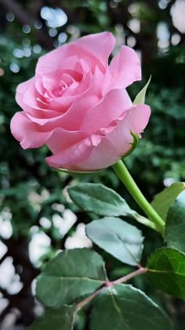
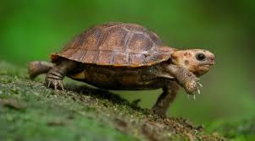
U and Uu Matra Words
Rose
Turtle

Slide 4
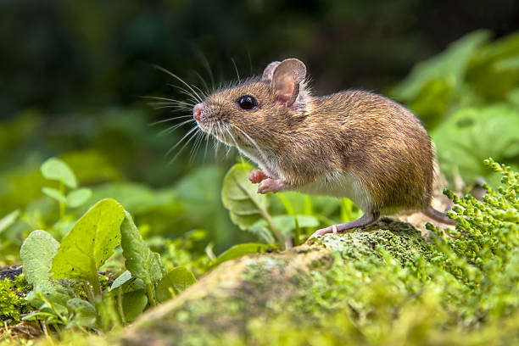
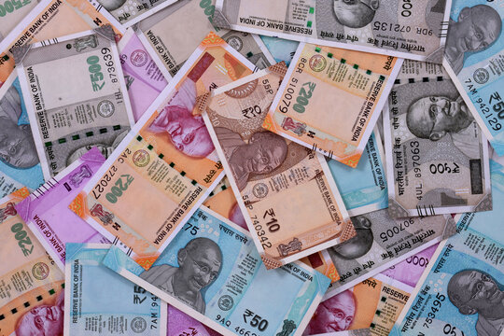
U and Uu Matra Words
Mouse
Rupees

Slide 5
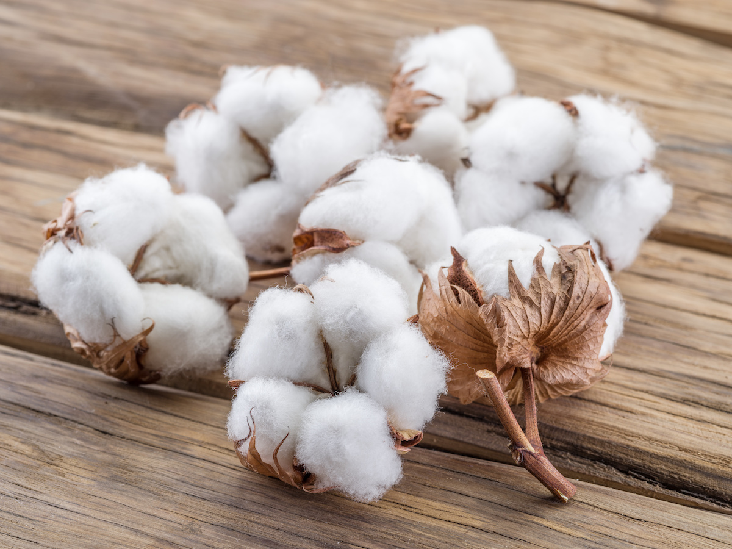
U and Uu Matra Words
Cotton
Rukk stop

Slide 6

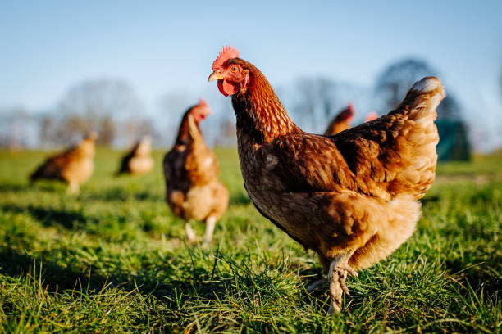
U and Uu Matra Words
Chup Quite
Murgaa hen

